Slide 1
TypeScript basics 2
Hardeep Kaur Dhalla

Slide 2
Objectives
OOPs review
Classes and objects
Constructors
Access modifiers
Inheritance

Slide 3
Object oriented programming
Think in terms of real-world objects.
There are 3 characteristics of OOPs
Inheritance
Encapsulation
polymorphism

Slide 4
Classes
ECMAScript 2015, also known as ES6, introduced JavaScript Classes.
TypeScript offers full support for the class keyword introduced in ES2015.
Classes are templates for JavaScript Objects.

Slide 5
Class Members
Fields - creates a public property on a class.
Getters/setters properties or accessor/ mutators
Methods - function keyword is not needed.
Static methods – static keyword is needed.
Constructors - for object initialization purposes
Classes can have readonly and optional properties.
We will discuss index signatures later…
To instantiate a class, we use the “new” keyword.

Slide 6
Create a class
The strictPropertyInitialization setting controls whether class fields need to be initialized in the constructor.
class Point {
x = 0;
y = 0;
}
const point = new Point();
// Prints 0, 0
console.log(`${point.x}, ${point.y}`);

Slide 7
strictPropertyInitialization flag set to true
class Point {
x: number;
y: number;
constructor(x:number, y:number){
this.x = x;
this.y = y;
}
}
const pt = new Point(2,5);
console.log(`${pt.x}, ${pt.y}`);

Slide 8
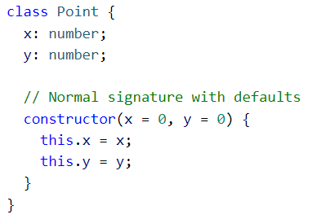
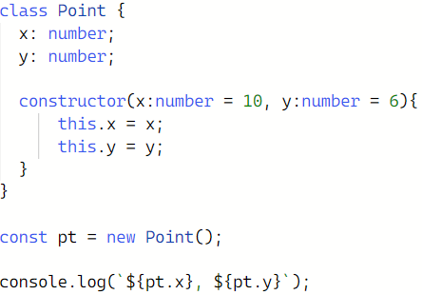
Constructors
You can add optional parameters while defining constructors.
You can add parameters default values.
Constructors can’t have return type annotations.

Slide 9
Constructor shorthand syntax
class Point {
x: number;
y: number;
constructor(public x:number, public y:number){
this.x = x;
this.y = y;
}
}

Slide 10
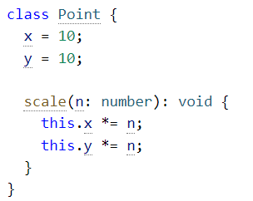
Methods
A function property on a class is called a method. Methods can use all the same type annotations as functions and constructors:

Slide 11
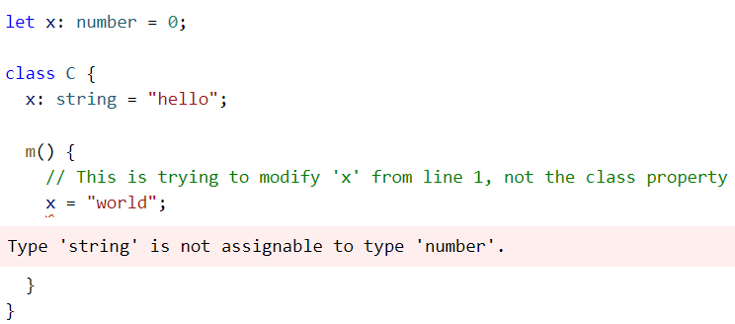
Methods
Note that inside a method body, it is still mandatory to access fields and other methods via this..

Slide 12
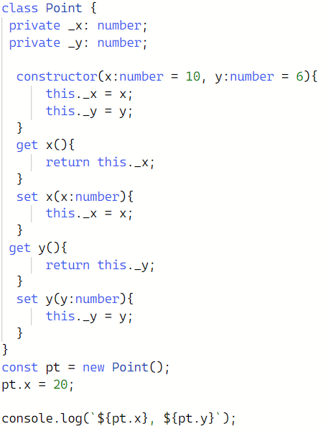

Slide 13
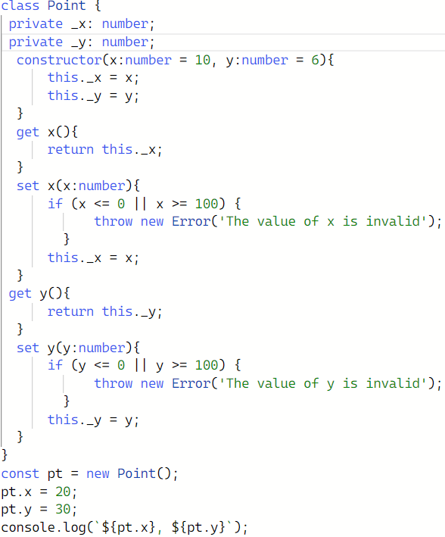

Slide 14
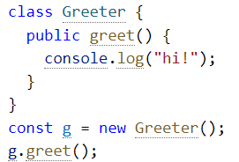
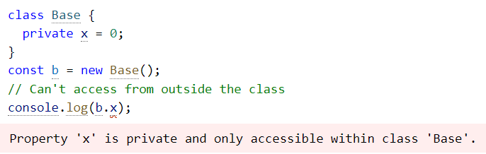
Member visibility
public – can be accessed anywhere. Default access is public.
Private – can only be accessed in the same class where they are defined .
Protected - can be accessed in the same class where they are defined or in the classes extending the functionality of this class.

Slide 15
Inheritance
Reusability and better organization of code.
Makes application maintenance easy.
Number of possible ways to do inheritance.
Class can extend another class using “extends” keyword.
A class can implement one or more interfaces using “implement” keyword.
A class also can also be abstract.

Slide 16
Angular-cli
The Angular CLI is a command-line interface tool that you use to initialize, develop, scaffold, and maintain Angular applications directly from a command shell.
https://github.com/angular/angular-cli

Slide 17
Angular CLI
Before we can start using the Angular CLI, we need to set up the following prerequisites for our system:
Node.js
Npm
Then we can install the Angular CLI using npm from the command line:
npm install –g @angular/cli
To verify that the Angular CLI has been installed correctly, we run the following command:
ng -version

Slide 18
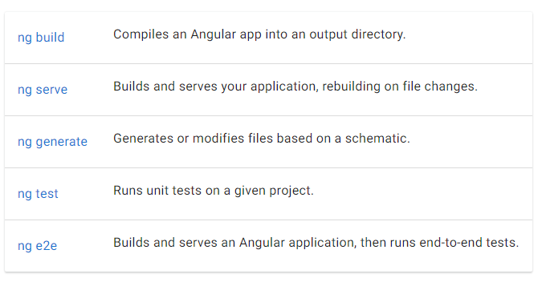
Angular CLI tool
The Angular CLI a valuable tool for building out your applications.

Slide 19
How to create an angular project?
Open command prompt after creating a workspace folder.
Type
ng new my-first-app // This command will create new angular project.
cd my-first-app
ng serve // to run the development server

